Slide 1
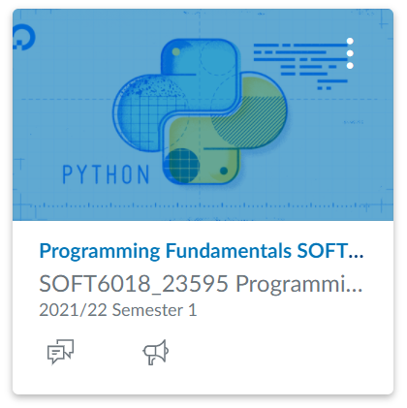
SOFT6018: Programming Fundamentals
Week 3 - Lecture 6

Slide 2
Software development is the process of going from a client’s requirements to a full solution

Slide 3
Understand what the client wants/needs
You will learn about this in Requirements Engineering in 2nd year
Design a solution
Implement the design and test the code

Slide 4
IPO
Processing
What must be done to go from the input to the output?
The series of steps produced here is called an algorithm
This is usually the most difficult task!
Input
Establish what data you need from the user – the inputs
What are the datatypes?
Output
What do you want to calculate for the user?
What do you want to show the user?

Slide 5


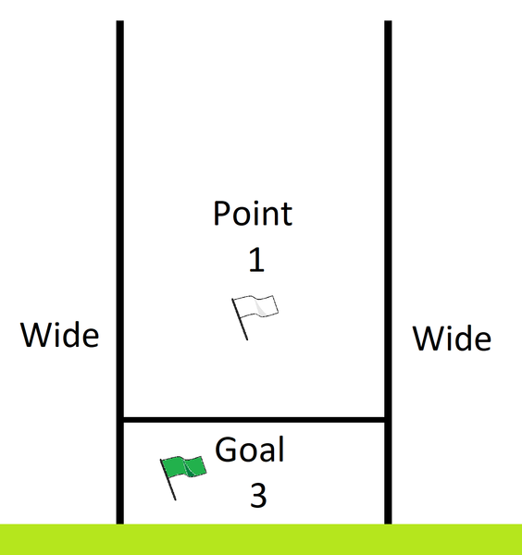

Consider the following challenge….
A program should get the name and score of a team in a GAA match and determine the total score in points.
In case you don't know….
In GAA, a score is made up of two elements:
Points – over the bar
Goals – under the bar & worth 3 points

Slide 6
The inputs?
Name of the team <string>
Number of goals <int>
Number of points <int>

Slide 7
The outputs?
A nicely formatted sentence with the name of the team, their score and the total points earned <string>

Slide 8
The processing?
total_points = goals*3 + points

Slide 9
IPO
Name of the team <string>
Number of goals <int>
Number of points <int>
total_points = goals*3 + points
A nicely formatted sentence with the name of the team, their score and the total points earned <string>

Slide 10
Algorithm
Ask for and read team's name
Ask for and read number of goals
Ask for and read number of points
total_points = goals * 3 + points
Display name, goals, points and total_points

Slide 11
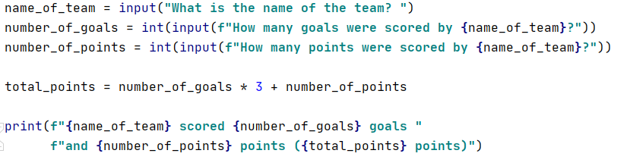
Algorithm

Slide 12
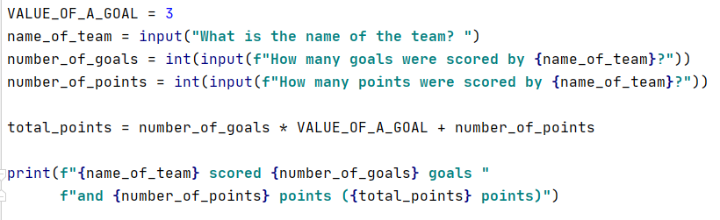
Algorithm – Improving readability
Replace the "magic number" 3 with a named constant to help others to read & understand your code
Also helps to quickly edit in the future
Recommended style uses capital letters

Slide 13
Do It Yourself
Write a program to ask the user for the money they have available to invest in the Post Office.
Each Post Office account delivers an interest rate of 3%, so the value of your savings will increase by 3% each year.
Write code to determine what the user’s account balance will be after 1 year.

Slide 14
MCQ announcement
Your quiz worth (10%) will take place during your 1-hour lab on the week starting Monday 16th October
Run using Canvas
In-person exam
Closed-book exam, no access to notes or the internet
Examining everything up to and including Week 3
Question types
Select one option from multiple choices
Select multiple options from multiple choices
Fill in the blanks
Match values

Slide 15
Lab exam 1 update
Your second assessment (15%) is an in-lab exam which will take place during your 1 hour lab during the week starting 6th November

Slide 16
print() function
print() takes any number of arguments and prints them out
The sep parameter puts a string between items
sep=‘*’ puts a * between items when printed
The default value for sep is a single space
The end parameter puts a string at the end of the line
end=‘*’ puts a * at the end of the printed line
The default value for end is a newline

Slide 17
Variables
Variable is a name that represents a space in memory
We can store data at that location
Assignment statements are used to create variables and assign values to that variable
variable_name = value
e.g. age = 29
= is the assignment operator, a special character in programming

Slide 18
Datatypes and type related functions
Datatypes:
integer
float
string
Functions
int() – converts a value to an integer (if possible)
int(7.9) -> 7
int(7.1) -> 7
float() – converts a value to a floating point number
float(5) -> 5.0
float(‘6.7’) -> 6.7
str() – converts a value to a string

Slide 19
input() function
input() reads user input from the keyboard
Always returns a string
String can be converted to another datatype if necessary
a_string = input('Enter your name: ')
a_decimal_number = float(input('Enter a number: '))
an_integer_number = int(input('Enter a number: '))

Slide 20
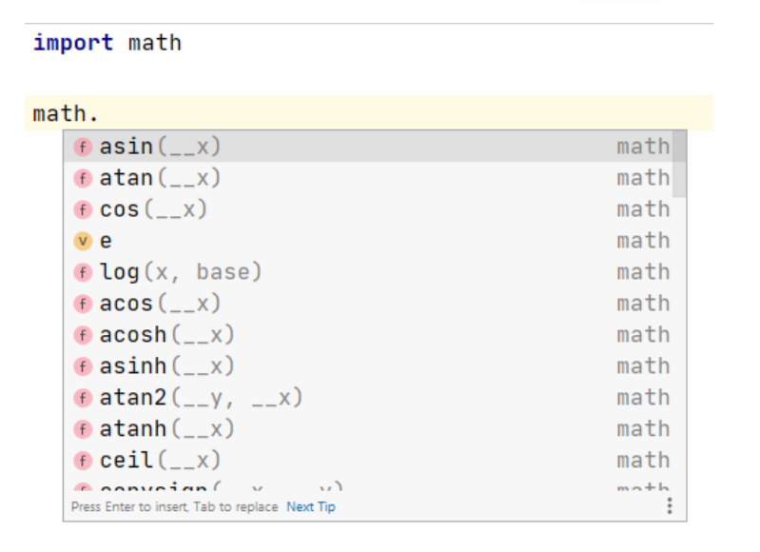
Math module
Python allows us to import specialist functions into our scripts
We have already utilised the math module
import math
The math module has lots of mathematical constants and functions e.g. math.pi, math.sqrt(7), math.cos(4)

Slide 21
Operators
+
-
*
/
// integer division
% remainder
** power

Slide 22
Things to note
If all values in an expression are integers, the result is an integer.
If one of the values is a float, the result would be a float.
4 + 5 -2 int
4 + 5 – 2.0 float
4 / 5 + 2 float (because of /)

